Slide 1
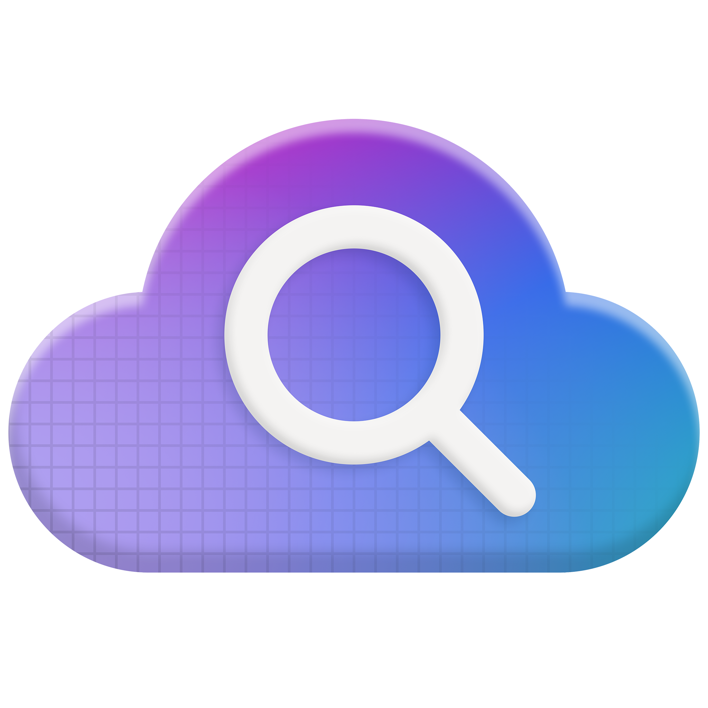
Theme 7 – Light - Quick start 2/2
Azure AI Search at Build
Sessions
Blogs
Session ID | Title | Times in PT
 | Title | URL
BRK155 | Azure AI Foundry: Agent factory | May 19 | 11:15am
DEM529 | Memory and agentic retrieval with AI Search | May 19 | 2:25pm
BRK141 | Knowledge retrieval: RAG for agents | May 19 | 6:00pm
COMM401 | Conversations: AMA with Pablo | May 20 | 5:45pm
BRK142 | Agentic RAG: build a reasoning retrieval engine | May 21 | 12:30pm
 | What’s new in Azure AI Foundry | aka.ms/Build25/HeroBlog/Foundry
 | Developer essentials in Azure AI Foundry | aka.ms/Build25/AzureAIFoundry
 | Introducing agentic retrieval | aka.ms/AgentRAG
 | Agentic retrieval eval results | aka.ms/AISearch-ARevals
 | Multimodality updates | Aka.ms/Build25/multim
Notes:
BRK141: https://build.microsoft.com/en-US/sessions?wt.mc_ID=Build2025_esc_corp_soc_oo_tw_MSEvents_SessionL&search=brk141&sortBy=relevance
BRK142

Slide 2
Get started Resources
Learn
Repos and samples
 | Name | URL
 | Name | URL
Docs: What’s new | aka.ms/AISearch-new
Learning plan: Create agents with Azure AI Foundry | aka.ms/CreateAgenticAISolutions
Quickstart: Multimodal | aka.ms/azs-multimodal-howto-portal
Quickstart: agentic retrieval in Python | aka.ms/AISearch-ar-pyn
Quickstart: agentic retrieval, AI Search & Foundry Agent service | aka.ms/AISearch-ar-agent
Sample app: Agentic retrieval | aka.ms/ragchat
Multimodal sample app | aka.ms/aisearch-multimodal
Azure MCP repo | aka.ms/azure-mcp
Foundry MCP server | aka.ms/foundry-mcp

Slide 3
Single-shot retrieval can’t tackle complex questions
Works
Doesn’t work
security updates KB4048959
what does ​KB4048959 fix and what systems is the patch compatibel with?
Notes:
KB4 – no context
Is the patch – core reference
In context spelling corrections

Slide 4

Announcement slide 3
Announcing
Agentic retrieval
Tackle tough questions from your agents
aka.ms/agentRAG

Slide 5
Agentic retrieval pupr announcement
Public preview
Agentic retrieval engine
Azure AI Search
Results tuned for answer generation, query activity log
Query planning & decomposition
Chat history
for context
Multiple parallel investigations
aka.ms/agentRAG

Slide 6
Announcing Agentic Retrieval
Query planning
Fan-out query execution
Results merging
Agentic retrieval engine
User query
Query planning
Search query 1
L1
L2
Merged results
…
L1
L2
Conversation turns
Search query n
L1
L2
Single LLM call
Use conversation history for context • Correct spellings in context • Decompose queries as needed • Paraphrase queries

Slide 7
Query planning & decomposition
Use chat history for context (the user said earlier it was a security fix)
Split queries for different information requirements, resolving co-references
what does ​KB4048959 fix and what systems is the patch compatible with?
Corrects spelling within context of sentence
Notes:
KB4 – no context
Is the patch – core reference
In context spelling corrections

Slide 8


What is included in my Northwind Health Plus plan that is not in standard?
Sub-query 1
Payroll deduction
Northwind Health Plus
Northwind Health Plus adds several types of coverage that the Standard plan does not have…
Query planning
Sub-query 2
Payroll deduction Northwind Health Standard
How much more does Northwind Health Plus cost?
Single LLM call to:
Incorporate conversation history for context
Correct spellings in context
Decompose queries as needed
Paraphrase queries
Conversation history
Query plan
Sub-queries
Single LLM call

Slide 9

Is agentic retrieval is actually better?
Query
Answer relevance
Is the answer relevant to the query?
Context relevance
Is the retrieved context relevant to the query?
Response
Context
Groundedness
Is the response supported by the context?
Source: The RAG Triad | www.trulens.org/getting_started/core_concepts/rag_triad/

Slide 10
Agentic retrieval evals
+40%
+30%
RAG answer relevance
RAG answer result rate
For complex queries requiring information from multiple documents
Full evals results and methodology description: aka.ms/aisearch-arevals

Slide 11
Agentic retrieval performance
for complex queries
+30%
+40%
100%
Context relevance
Answer relevance
Groundedness
(no negative impact)
Full evals results and methodology: aka.ms/aisearch-arevals
2. Cut Costs, Not Quality: Optimize Azure AI Search with Advanced Compression

Slide 12
ATT quote
"Our applications must deliver high RAG performance quality, and to uphold these standards, we rely on AI Search to provide us with the latest retrieval technology.
We are looking forward to using Azure AI Search’s agentic retrieval with our agents to match the speed, complexity and diversity of information we’ll need to hit our targets.“
Mark Austin, Vice President, Data Science, AT&T
AT&T

Slide 13
Agentic retrieval pupr announcement
Public preview
Multimodality updates
Azure AI Search
Improved chunking for long text
Layout and image extraction
Multimodal sample app
aka.ms/Build25/multim

Slide 14
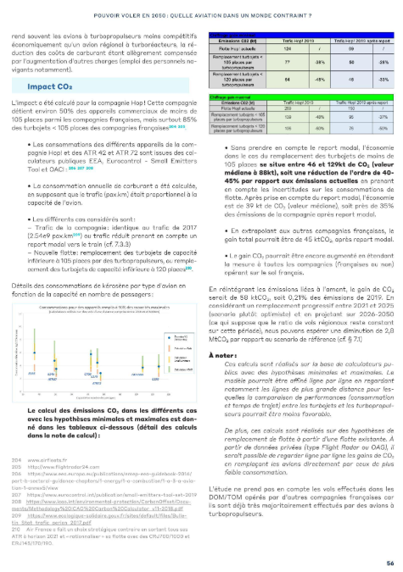
Powering multimodal scenarios
3
1
Verbalize images using a generative model
→ New GenAI Prompt Skill
2
Extract images so they can be used in app UI
→ Knowledge store
3
1
Extract and propagate layout information
→ Azure Document Intelligence
2
4
More options for chunking long text
→ Split skill improvements
4

Slide 15
Agentic retrieval pupr announcement
Public preview
Multimodality updates
Azure AI Search
Improved chunking for long text
Layout and image extraction
Multimodal sample app
aka.ms/Build25/multim

Slide 16
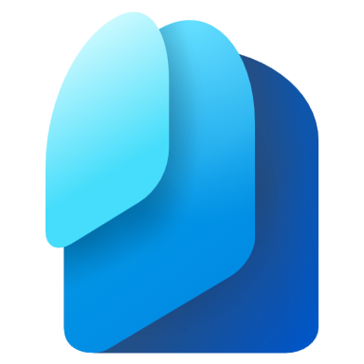


Native Entra-based access control
Announcing
Azure AI Search index
Microsoft Entra
id | Text, vector, metadata fields… | userIds | groupIds
… | … | … | …
… | … | … | …
… | … | … | …
… | … | … | …
id | Text, vector, metadata fields… | userIds | groupIds
… | … | … | …
… | … | … | …
Calling user/agent identity
Which groups can see this?
Which users can see this?

Slide 17
Propagate ACLs from data sources with indexers
1) Enable permission propagation in data source
{
"name": "mydatasource",
"type": "adlsgen2",
"indexerPermissionOptions": ["userIds", "groupIds"],
…
}
Two options for placing ACLs in Azure AI Search:
Push: bring your own ACL information
Pull: indexers propagate ACLs automatically
→ Starting with ADLS gen2, OneLake and others to follow
2) Map security fields to index fields in indexer
{
"name": "myindexer",
"dataSourceName": "mydatasource",
"targetIndexName": "myindex",
"fieldMappings": [
{ "sourceFieldName": "metadata_user_ids", "targetFieldName": "users" },
{ "sourceFieldName": "metadata_group_ids", "targetFieldName": "groups" }
],
…
}

Slide 18
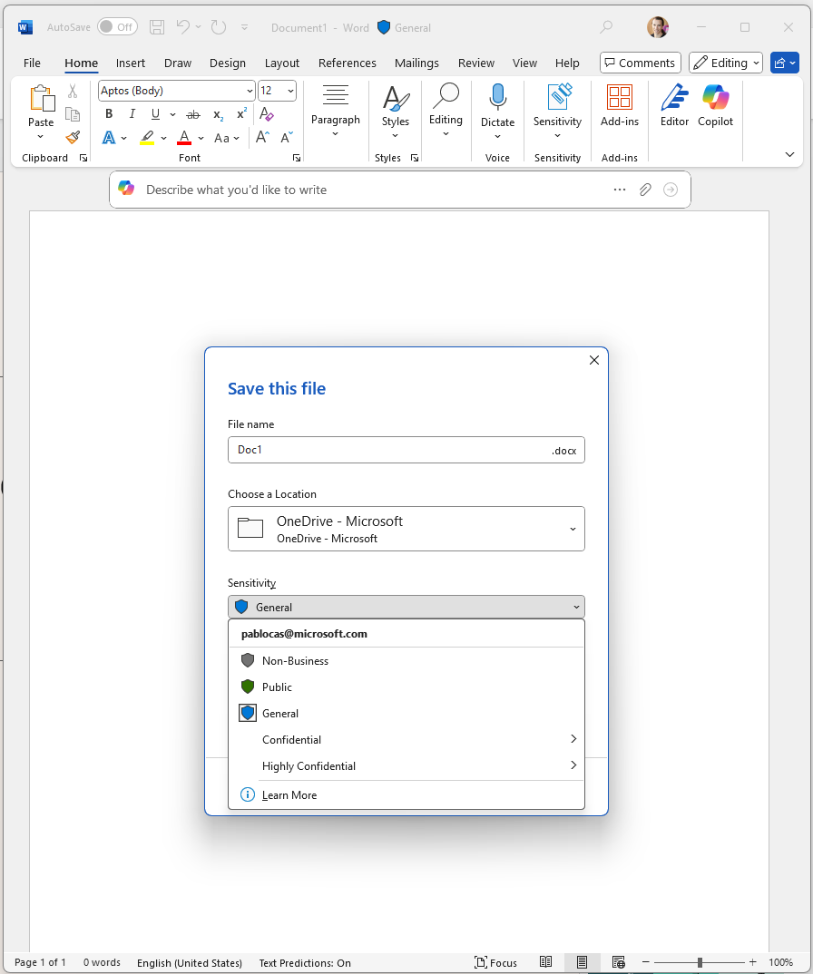
Sensitivity labels
Labels classify and protect enterprise data
Part of the Microsoft Purview governance capabilities
ACLs
File container:
e.g. blob storage, OneLake, ADLS
Labels are part of the document, independent of container
Azure AI Search now can:
Index encrypted content
Enforce label-associated policies
Label + policy

Slide 19
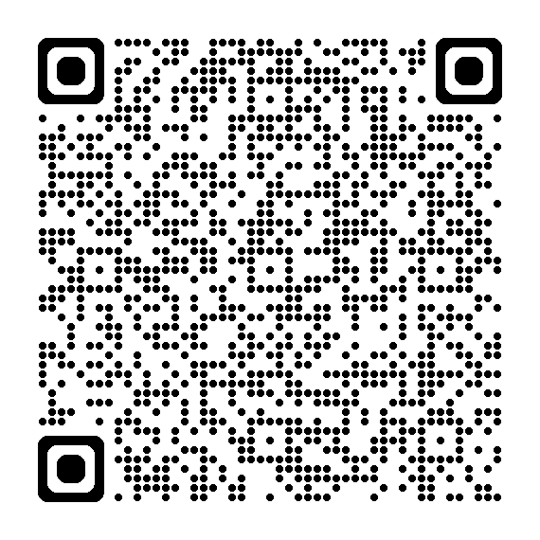
Want to test out sensitivity labels?
Join private preview
aka.ms/AISearch-senslabels

Slide 20
Spirax quote
We’re exploring Azure AI Search’s multimodal capabilities to enhance MiM, our AI-powered knowledge assistant. We are enabling MiM to interpret and retrieve information from complex technical documentation and proprietary knowledge sources—including diagrams, structured tables, and embedded visuals.
Early access and close collaboration with Azure AI Search have enabled us to test emerging capabilities in real-world scenarios. While it’s still early days, we’re encouraged by the progress and excited to continue this journey together.
Subhas Patel, Group Head of Technology, Spirax Group
Spirax Group

Slide 21
Thank you
Sessions
Session ID | Title | Times in PT
BRK155 | Azure AI Foundry: Agent factory | May 19 | 11:15am
DEM529 | Memory and agentic retrieval with AI Search | May 19 | 2:25pm
BRK141 | Knowledge retrieval: RAG for agents | May 19 | 5:30pm
COMM401 | Conversations: AMA with Pablo | May 20 | 5:45pm
BRK142 | Agentic RAG: build a reasoning retrieval engine | May 21, 12:30pm
LAB335-R1 | Build your first agentic RAG solution with Azure AI Search | May 21, 4:30pm
 | Expert booth: Azure AI Search

Slide 22
Theme 7 – Light - Quick start 2/2
Azure AI Search at Build
Sessions
Blogs
Session ID | Title | Times in PT
 | Title | URL
KEY01 | Announcement in Satya Day 1 keynote | 42:52
BRK155 | Azure AI Foundry: Agent factory | May 19 | 11:15am
DEM529 | Memory and agentic retrieval with AI Search | May 19 | 2:25pm
BRK141 | Knowledge retrieval: RAG for agents | May 19 | 6:00pm
COMM401 | Conversations: AMA with Pablo | May 20 | 5:45pm
BRK142 | Agentic RAG: build a reasoning retrieval engine | May 21 | 12:30pm
 | What’s new in Azure AI Foundry | aka.ms/Build25/HeroBlog/Foundry
 | Developer essentials in Azure AI Foundry | aka.ms/Build25/AzureAIFoundry
 | Introducing agentic retrieval | aka.ms/AgentRAG
 | Agentic retrieval eval results | aka.ms/AISearch-ARevals
 | Multimodality updates | Aka.ms/Build25/multim
Notes:
BRK141: https://build.microsoft.com/en-US/sessions?wt.mc_ID=Build2025_esc_corp_soc_oo_tw_MSEvents_SessionL&search=brk141&sortBy=relevance
BRK142

Slide 23
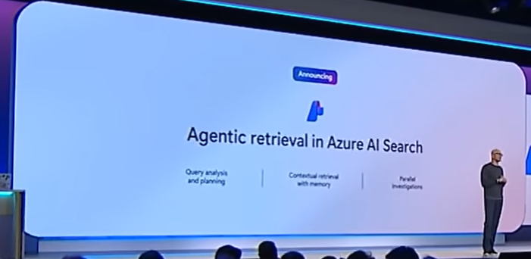

Theme 7 – Light - Quick start 2/2
Keynote
Sessions
Blogs
Session ID | Title | Times in PT
 | Title | URL
KEY01 | https://youtu.be/ceV3RsG946s?si=g1DZs6DDUFSzFdGy&t=2572 | 42:52
Notes:
https://youtu.be/ceV3RsG946s?si=g1DZs6DDUFSzFdGy&t=2572

